Slide 1
Agenda
1. Requirements and communication (Cross – Departments)
2. Development Stage – Prototype
3. Presentation on prototype – Fine Tune
4. Delivery on production stage – User Training and Report Maintenance
5. Main Challenges as PBI developer

Slide 2

1. Requirements and communication
Communicate with main report users on details of business requirement: we need to cover 10 different countries, how to identify healthy/unhealthy margin (benchmark/target margin), produce segmentation etc.
Initiate the report requirement : we need an APAC margin analysis report , we want to see Margin performance tracking, identify major gain and major loss
2
Main Audience (Pricing/Product Team,etc)
1
Sponsors(Pricing VP and CFO)
PBI Main Developer
Database Admin/Data Engineer
4
3
Quick feedback on potential report scope and get the confirmation: we can do by region, margin tracking benchmark with target margin, YoY, MoM, etc.
Communicate with IT/Data Admin on available data scope: After check with data admin, we realized Target margin records and China order transactions all sitting in different system not in current pool, we need to do some ETL to get the correct info
The Step 1 to 4 , may need to repeat serval rounds during the communication stage

Slide 3
2. Development Stage – ETL
ETL Process
APAC Main Order Report(current pool)
China Order Report (from China transactional database)
APAC Target Margin Report
Data Source
Extract and transform all data fields required– Order data 1
Date scope: All orders from FY 2021 to FY 2027, etc.
Extract and Transform all data fields required – Order data 2
- Same data scope as APAC Main order report
Extract and Transform all data fields required – Target Margin
Order number, Product Model, Target Margin, etc.
Dataset Extracted and Transform
Master Table/Data cube
Create the Master table( Margin Tracking Table) can be done by SQL or PBI Query :
Order data 1 + Order data 2 by appending method – Combined Order data
Combined Order data + Target Margin report by merging method (left Join) – Margin Tracking table
Complete the whole data pipeline procedure
Connection to PBI
Use “Get Data” from PBI desktop to build the connect with data from SQL server to develop PBI visual

Slide 4
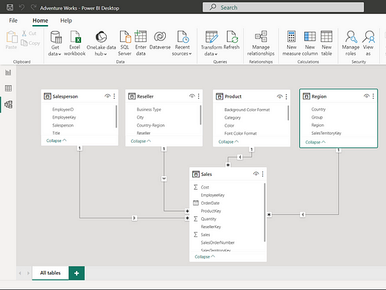
2. Development Stage – Data Modeling in PBI
Data Model – Star Schema
Fact table (Margin Tracking Table): which include all information like , order number, product model, margin, closed date,
Dim table 1 (date table): For every data model in PBI, I normally strongly suggest to have an separated Calendar table ( date table) created in PBI
Dim table 2: (Product table): more details information on each product , segmentation,
Dim table 3 (Customer table): with more details on customer, address, tier , type, etc

Slide 5
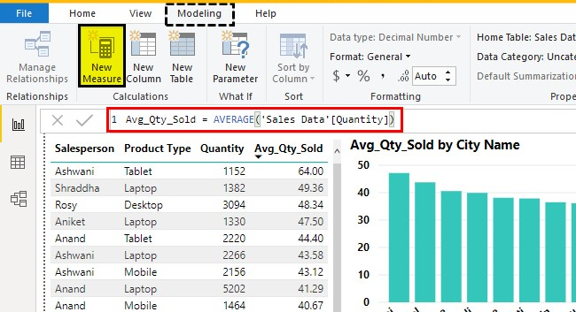
2. Development Stage – Data Analytic
Data Analytic – DAX /M Function
DAX functions Example:
YTD Sales= CALCULATE(sales , DATESYTD(Dates,"31/12"))
Pervious Month Margin%= CALCULATE(Margin%, PREVIOUSMONTH(Dates)
Rolling 12 month Sales= CALCULATE(Sales,DATESBETWEEN(month,EDATE(MIN(month),-11),MAX(month)))
Calculated column vs Measures:
Calculated column: work on row basis, can read whole row content regardless of visual, so can use it as filter/slicer, but consumes more RAM
Measures: work at the aggregate level, granularity depend on visual, more efficient, but cannot be a filter/slicer

Slide 6
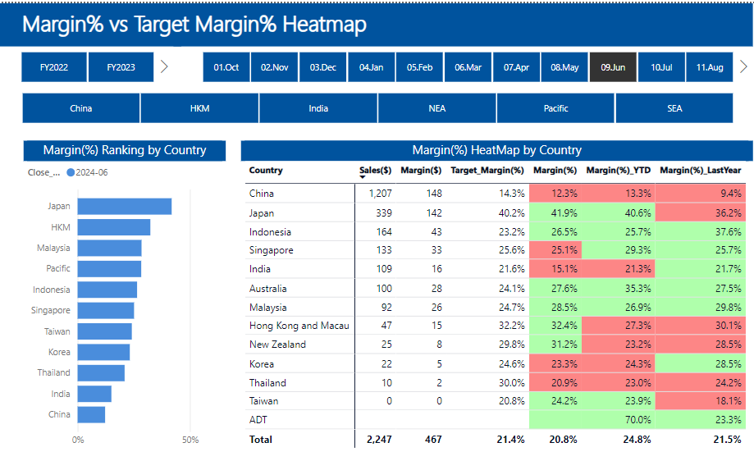
2. Development Stage – Create Visual
Main theme, Company logo, color design align with company PBI policy, as well as UI design principle
Design the Page:
what the main focus of this page : margin tracking table by country
How many Visuals on Canvas: too many visuals may not a good thing
Choose right visuals for each analysis: Bar chart/Line chart/Table/ etc.
Enable interactive function: press on one , other chart will follow as well
Conditional formatting
Tooltips
Etc. etc

Slide 7


3. Presentation on prototype – Fine Tune
Present the draft version to the Sponsors and Main Audiences: get feedback and fine tune with current model , until we agree on the output
Sponsors(Pricing VP and CFO)
Main Audience (Pricing/Product Team,etc)
Communicate clear on the production launch date, data refresh schedule , user list, data access restriction , and training schedule

Slide 8
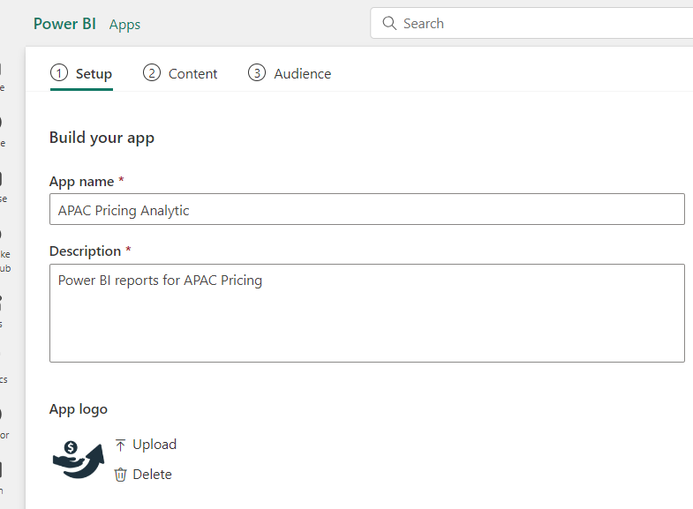
4. Delivery on production stage – User Training and Report Maintenance
Develop the full scope of report and work with data admin/data engineer team on data pipeline automation and refreshing schedule
Use Row-level security (RLS) to restrict user’s access: e.g. Singapore team can only see Singapore data based on company email
Sponsors(Pricing VP and CFO)
Database Admin/Data Engineer
Main Audience (Pricing/Product Team,etc)
Publish the report on PBI service (production side) as an APP, and share with all audience, and provide training as scheduled

Slide 9
5. Main Challenges as PBI developer
Clarify on Reports requirement with Main Sponsors (Senior Management): sometimes they may not able to express clearly on the requirements yet, and we need try and see like experiments – quick feedback with a draft version, and do not spend too much time on beatify the report at development stage
When users point out your data are wrong!: the reason users can immediately identify your data not correct , and normally you end up like ants on hotpot ,anxious and don’t know where is the issue – set up a validation system are very important but ofter been ignored , our data flow from system to data warehouse to PBI to the visuals , then to User , each step may cause the issue , set up auto validation practice by each step, could easily find out step with issue
Bottlenecked by technical issue: this is very common for any engineer or tech related role , for my own personal experience , don’t close the door and try to solved by yourself only, try to ask another colleagues, try to google, and if the deadline is approaching, try to give a alternative solution, and actively feedback the progress

Slide 10
Thank you!

